Slide 1
ADAPTOR Pattern
Just think in real life where you use adaptor?
Adapter pattern acts as a bridge between two incompatible objects which are mostly interface and class.
This pattern involves a single class called adapter which is responsible for communication between two independent or incompatible interfaces.

Slide 2


Slide 3


Slide 4
This is an interface which is used by the client to achieve its functionality/request.
Now
Lets create a class which will have the functionality, required by the client. However, its interface is not compatible with the client.

Slide 5
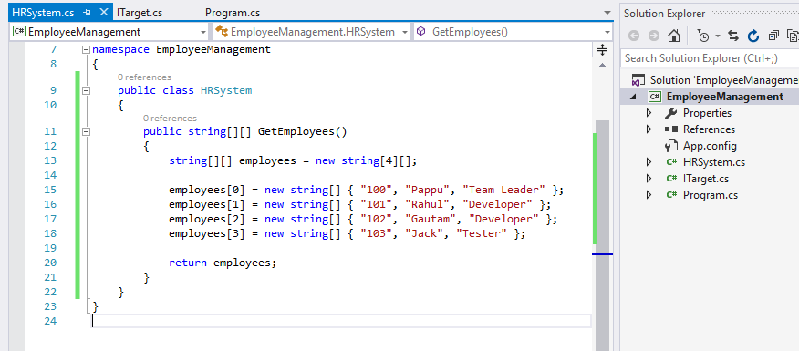

Slide 6


Slide 7
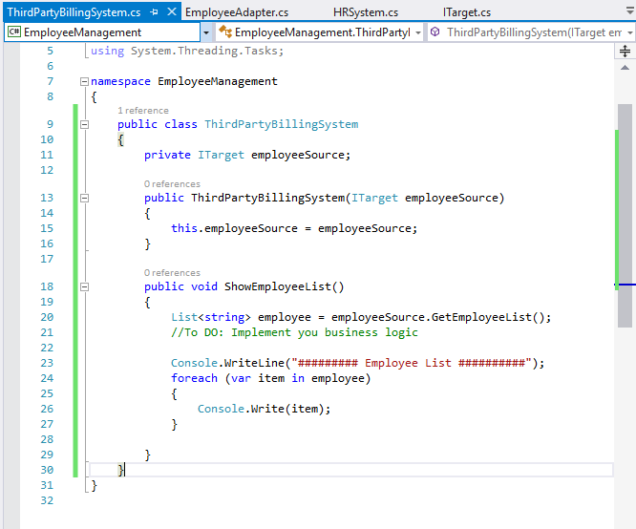
This is a class which interact with a type that implements the ITarget interface. However, the communication class called adaptee, is not compatible with the client

Slide 8
Now it’s a time to create a class which implements the ITarget interface and inherits the Adaptee class. It will be responsible for communication between Client and Adaptee.

Slide 9
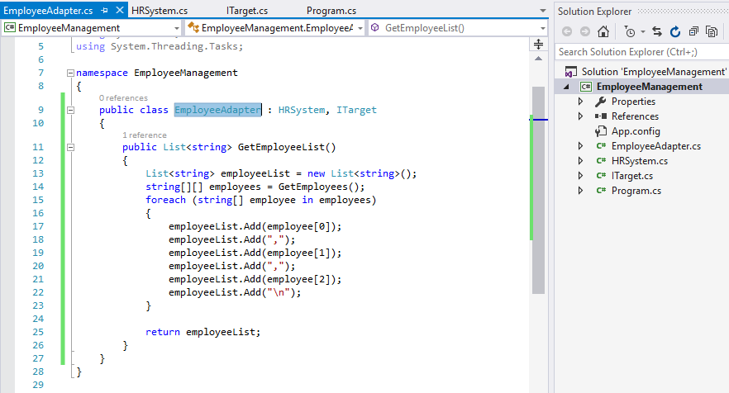

Slide 10
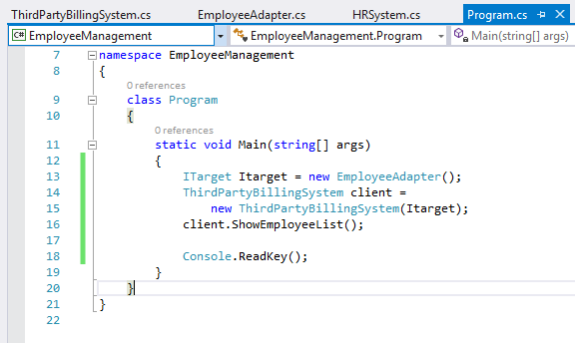

Slide 11
